Slide 1

Introduction & Data science platforms
資料科學 Data Science
張家銘 Jia-Ming Chang
政治大學資訊科學系
The slide is only for educational purposes. If any infringement, please contact me. We will correct immediately.

Slide 2
Copyright declaration 版權說明
Some of the figures in this presentation are taken from "An Introduction to Statistical Learning, with applications in R" (Springer, 2013) with permission from the authors: G. James, D. Witten, T. Hastie and R. Tibshirani.
The web site of the book
The credit of individual is indicated in the bottom part of the slide.
ie.,

Slide 3
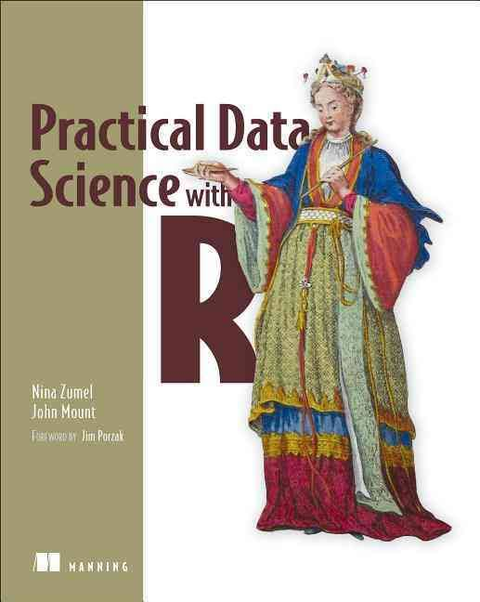
Copyright declaration 版權說明
Some of the figures in this presentation are taken from "Practical Data Science with R (Manning, 2019)”
The web site of the book
The credit of individual is indicated in the bottom part of the slide.
ie.,

Slide 4
Copyright declaration 版權說明
Some of the figures in this presentation are taken from "R for Data Science” under the Creative Commons Attribution-NonCommercial-NoDerivs 3.0 License.
The web site of the book
The credit of individual is indicated in the bottom part.
ie.,

Slide 5




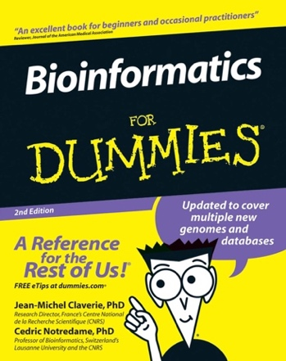

Dr. Chuan Yi Tang
1996 ~ 2000 Bachelor (推薦甄試入學)
2002 ~2002 Master
@ Computer Science, National Tsing Hua Uni.
2002 ~ 2008 military replace service
@ Institute of Information Science
Academia Sinica
Dr. Ting-Yi Sung
Dr. Wen-Lian Hsu
2008~2013 PhD La Caxia fellowship
@ The Centre for Genomic Regulation Barcelona, Spain
Dr. Cedric Notredame
2014~2016 Postdoc
@ Institute of Human Genetics
Montpellier, France
Dr. Giacomo Cavalli

Slide 6
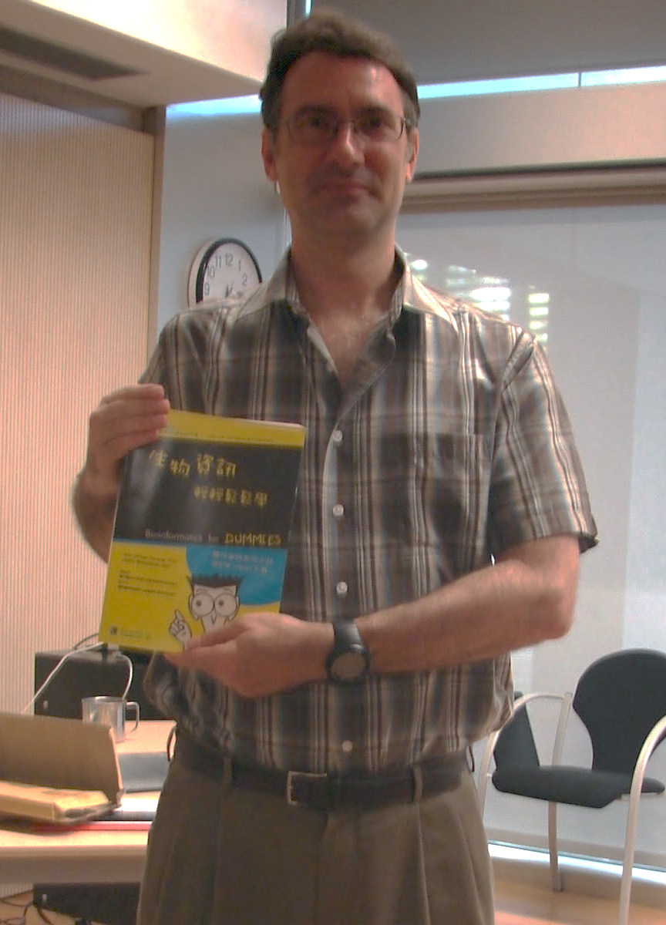

Slide 7


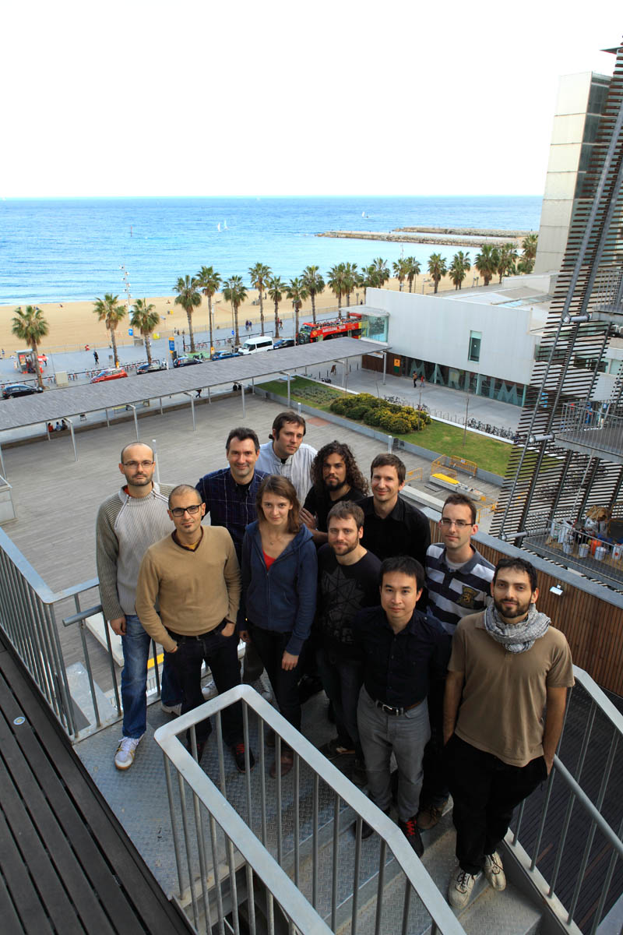
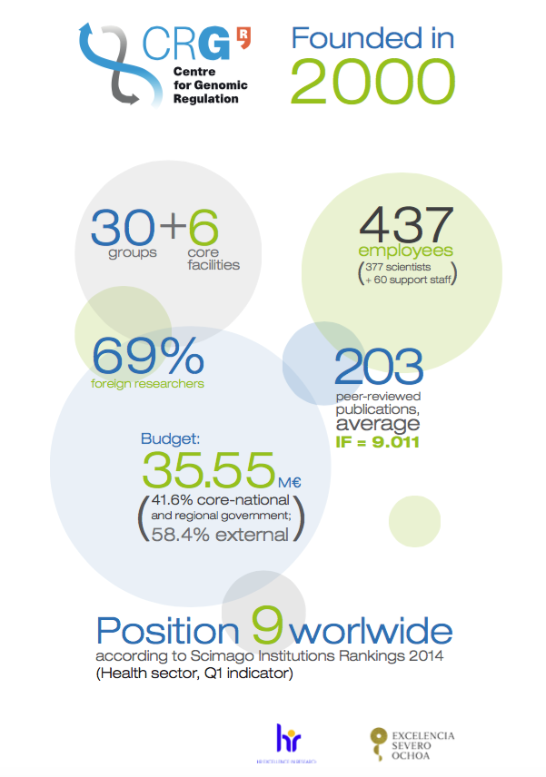
https://goo.gl/photos/AT6QkCgfVH8JsmH69
https://goo.gl/photos/dBiRxWYxbWSsbCHA8

Slide 8


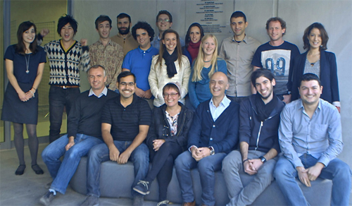
The Institute of Human Genetics
The French National Centre for Scientific Research
302 publications between 2008 and 2012
20 % of these research papers with an IF >10
2 Nature, 9 in other Nature series, 6 Cell, 2 Science, 7 Genes & Dev,
6 Mol Cell, 7 EMBO J, 5 PNAS
the mean of IF is 6.4
Genome Dynamics, Giacomo Cavalli’s Lab
25 papers in high-impact journals
Cell, Science, Nature Genetics, PLoS Biology.
Awards:
the silver medal of the CNRS
EMBO fellow
He is directly involved in the FP7 EpiGeneSys NoE as board member.
2008 ERC Advanced Investigator Grant, 2.2 million euro
Notes:
Cell IF : 32.242 Science : 33.611

Slide 9
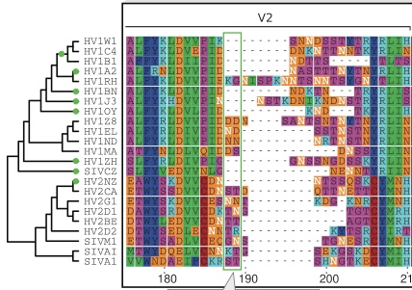
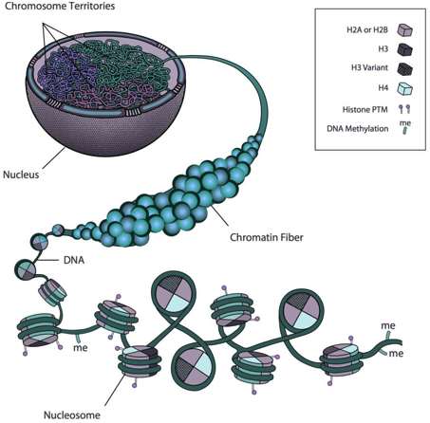
Big/Biodata Science lab (BBS)
巨觀生物資料科學實驗室
Computational protein function prediction
Large scale alignment & phylogenetic tree
3D organization of chromosomes

Slide 10
What is data science?
1

Slide 11
Data science Is the fastest growing industry
https://opensource.com/business/14/12/r-open-source-language-data-science

Slide 12
Data science Is the fastest growing industry
http://datasci.tw/

Slide 13
Data Science
The statistician William S. Cleveland defined data science as an interdisciplinary field larger than statistics itself.
statistics
machine learning
programming / computer science
data engineering
Practical Data Science with R by Nina Zumel, John Mount

Slide 14
Data Science
as managing the process that can transform hypotheses and data into actionable predictions
predicting who will win an election
what products will sell well together
which loans will default
which advertisements will be clicked on
Practical Data Science with R by Nina Zumel, John Mount

Slide 15



Slide 16
Data Science
The data scientist is responsible for
Data : acquiring the data, managing the data
Modeling: choosing the modeling technique, writing the code
Evaluation: verifying the results
Practical Data Science with R by Nina Zumel, John Mount

Slide 17

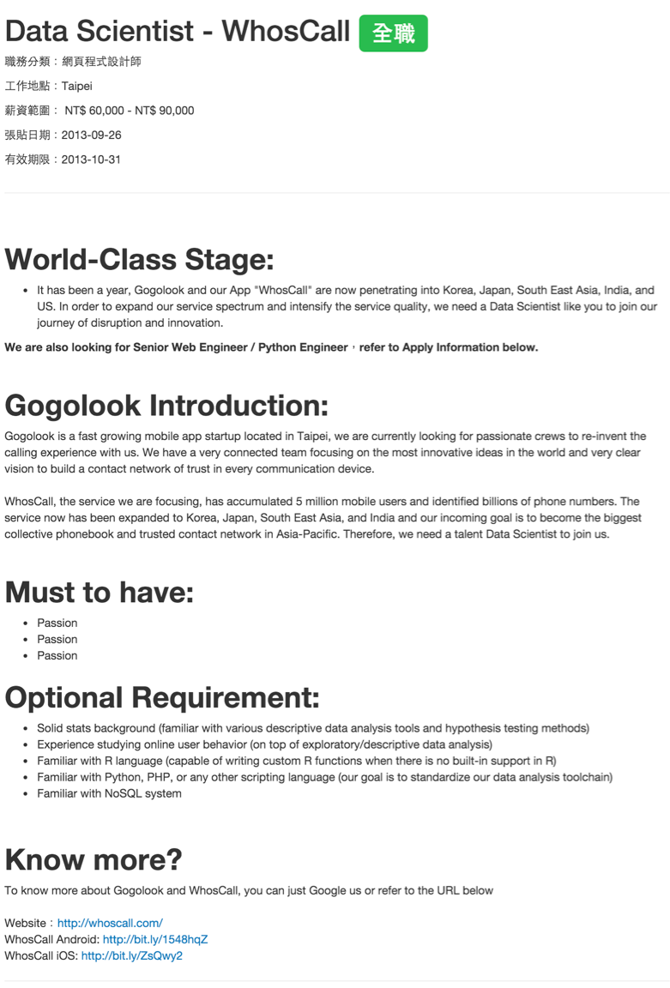
An example @ Job market
https://www.techinasia.com/korean-web-giant-naver-acquires-taiwanese-startup-gogolook

Slide 18
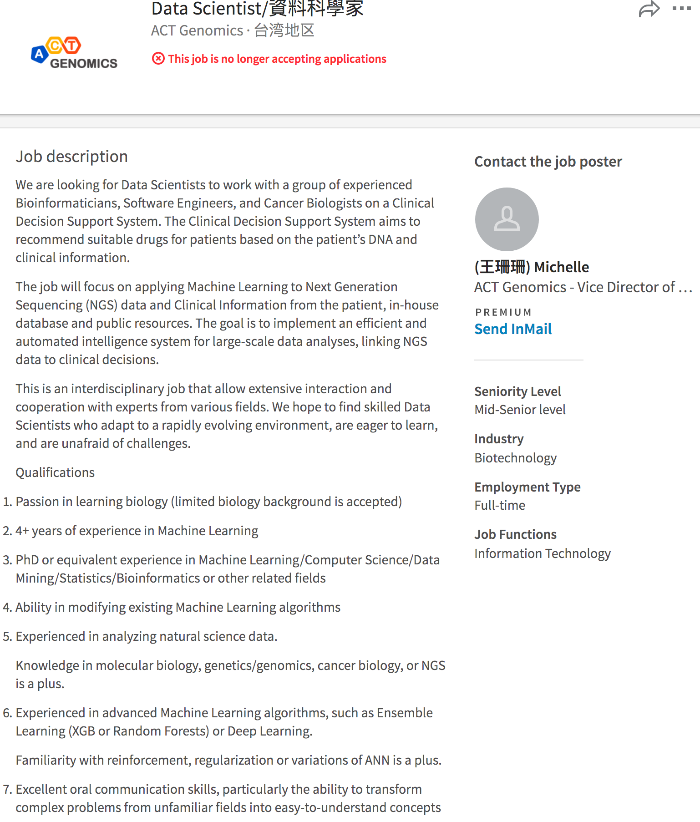
An example @ Job market
https://www.linkedin.com/jobs/view/370881654/?fref=gc&dti=183664932063716

Slide 19
The course
This course will introduce you to the work of data science
It is an introduction to an advanced topic
We will concentrate on a portion of data science related to scoring and prediction
We will work examples with actual data using an analysis system called R
Lectures will be
Slides
On-hand programing
R for Data Science by Garrett Grolemund, Hadley Wickham
http://winvector.github.io/IntroductionToDataScience

Slide 20
Scheduled Progress
Web site
http://www.changlabtw.com/1091-datascience.html
http://winvector.github.io/IntroductionToDataScience

Slide 21
supervised v.s. unsupervised
supervised statistical learning
involves building a statistical model for predicting, or estimating, an output based on one or more inputs
unsupervised statistical learning
there are inputs but no supervising output; nevertheless we can learn relationships and structure from such data
An Introduction to Statistical Learning with Applications in R by Gareth James, Daniela Witten, Trevor Hastie, Robert Tibshirani
http://winvector.github.io/IntroductionToDataScience

Slide 22
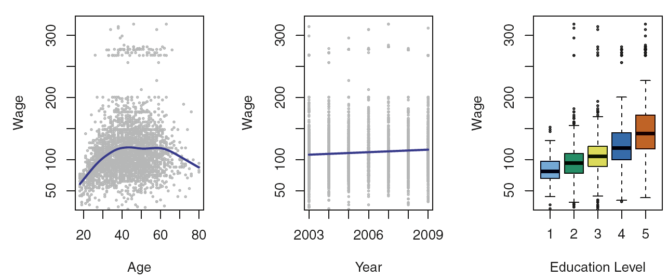
Supervised
Figure 1.1, An Introduction to Statistical Learning with Applications in R by Gareth James, Daniela Witten, Trevor Hastie, Robert Tibshirani

Slide 23
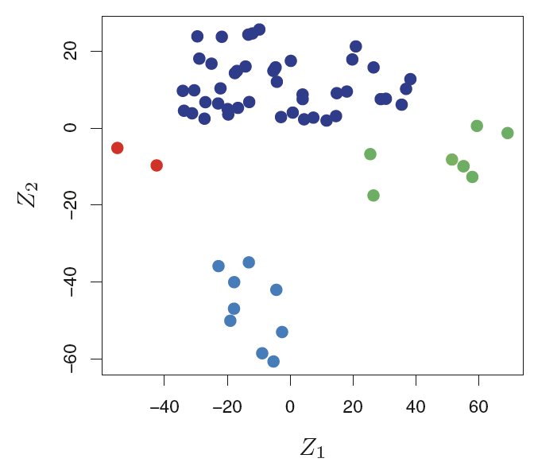
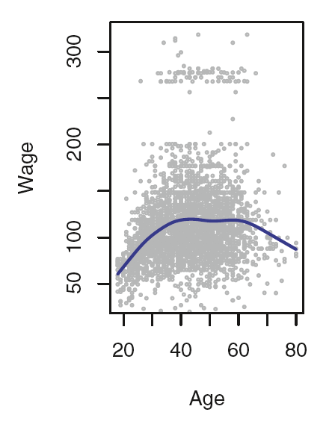
Regression v.s. Classification
Figure 1.1 & 1.4, An Introduction to Statistical Learning with Applications in R by Gareth James, Daniela Witten, Trevor Hastie, Robert Tibshirani

Slide 24
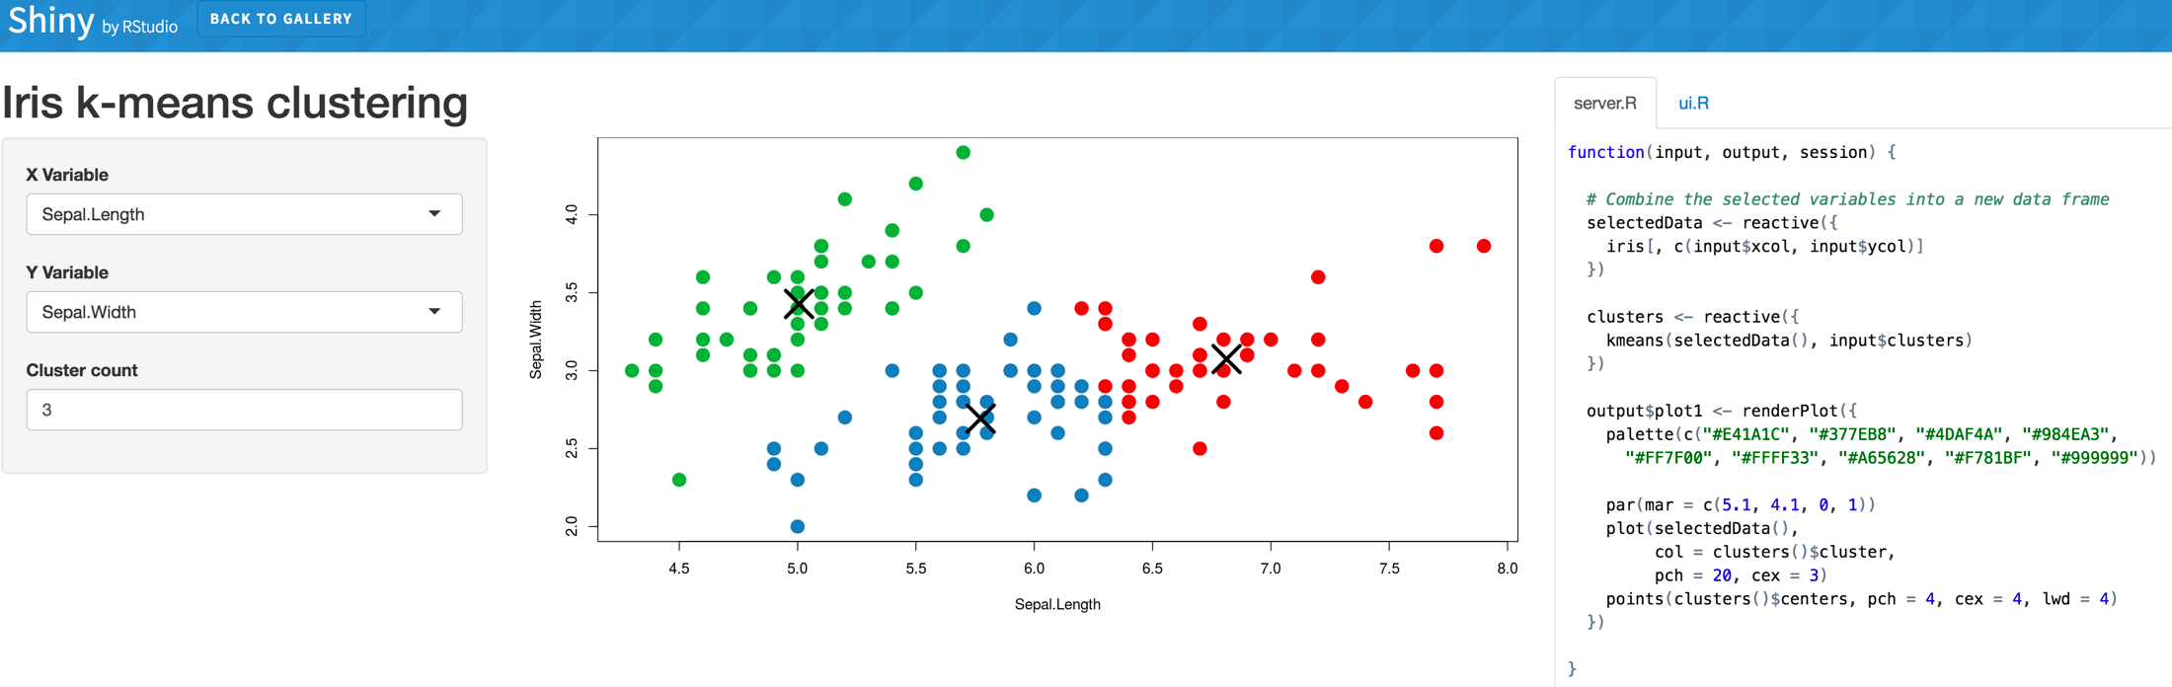
Visualization
http://shiny.rstudio.com/gallery/kmeans-example.html
http://winvector.github.io/IntroductionToDataScience

Slide 25
What is not in the course?

Slide 26
What is not in this course?
Big data (engineering) or hardware implementation
How to implement your own machine learning algorithms
Except for one example we emphasize exploring
and using already available machine learning libraries
=> thanks rich R package libraries
http://winvector.github.io/IntroductionToDataScience/

Slide 27
What is not in this course?
Deep Learning
https://www.deeplearning.ai/
http://bangqu.com/Wi6Zfj.html

Slide 28
What is not in this course?
Python, Julia, and friends
You won’t learn anything about Python, Julia, or any other programming language useful for data science. This isn’t because we think these tools are bad. They’re not! And in practice, most data science teams use a mix of languages, often at least R and Python.
R for Data Science by Garrett Grolemund, Hadley Wickham

Slide 29
Reference Books

Slide 30
Practical Data Science with R
Zumel, N. & Mount, J. (Manning)
1th, 2014 @ 天瓏書局 1320
2th, 2019 @ 天瓏書局 1530
Example R scripts and data https://github.com/WinVector/zmPDSwR

Slide 31
An Introduction to Statistical Learning with Applications in R
by Gareth James, Daniela Witten, Trevor Hastie and Robert Tibshirani
Hastie and Tibshirani coined the term generalized additive models in 1986 for a class of non-linear extensions to generalized linear models
Download the book PDF

Slide 32
An Introduction to Statistical Learning with Applications in R
Statistical Learning MOOC covering the entire ISL book offered by Trevor Hastie and Rob Tibshirani.
https://lagunita.stanford.edu/courses/HumanitiesSciences/StatLearning/Winter2016/about

Slide 33
R for Data Science
Import, Tidy, Transform, Visualize, and Model Data
by Hadley Wickham, Garrett Grolemund
Hadley Wickham：一个改變了R的人
Where?
Amazon
On-line
http://r4ds.had.co.nz/index.html

Slide 34
About the course

Slide 35
授課方式
Lecture
MOOCs
Hands-on Programming

Slide 36
Grading standards
55 Homework
15 Midterm
20 Final project
10 Zuvio questions
< 5 Attendance/Participation Bonus
actively attend course
ask questions
rounding into integer: round(x)
round(89.5) = 90
round(89.4) = 89

Slide 37
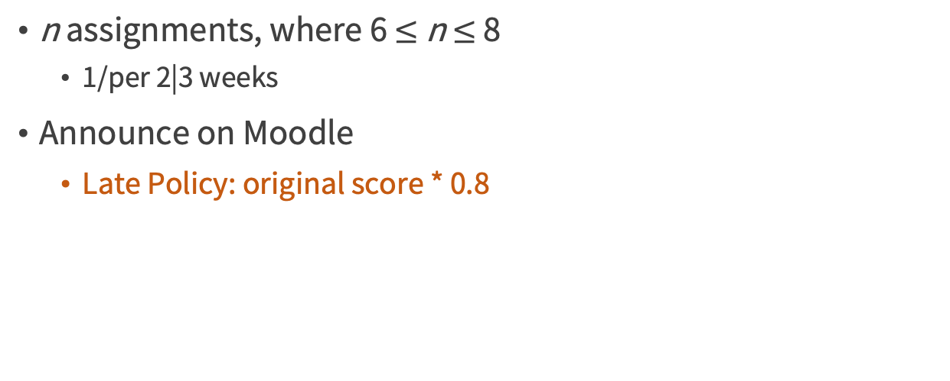
Homework
n assignments, where 6 $≤$ n $≤$ 8
1/per 2|3 weeks
Announce on Moodle
Late Policy: original score * 0.8

Slide 38
Midterm
One A4 page note only
Can't use calculator/computer
One point for each question, total 15 points. You can answer in English or Chinese.
Absent is not accepted
Medical certification if temporary illness
There will be a more rigorous retest if needed

Slide 39
Final Project
Collect your data before the midterm
From your own research project
Online data set @ https://www.kaggle.com
Final presentation
Upload your code/document into GitHub

Slide 40
Final Project
10 iVoting
10 Internal-group judgement

Slide 41
Science Misconduct
台大生化所論文圖片不當引用，引發學術圈關注
Credit by廖英凱 泛科學
http://pansci.asia/archives/flash/109111

Slide 42
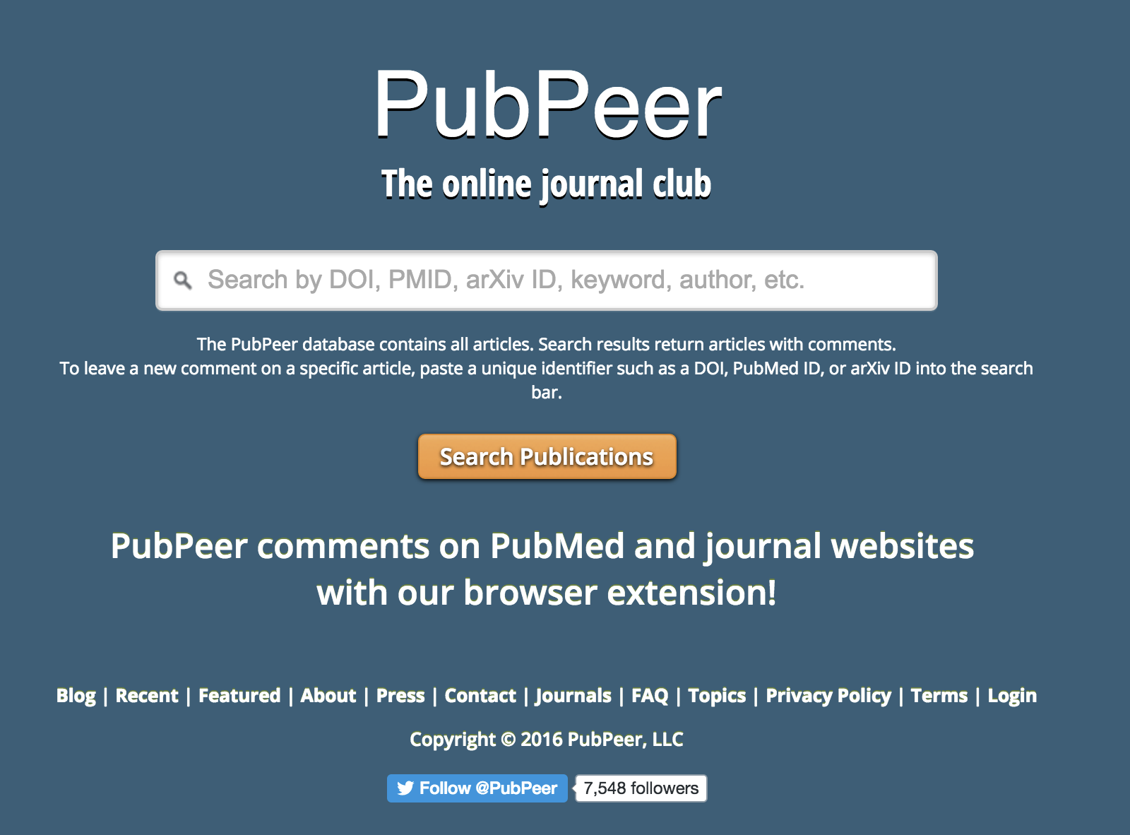
PubPeer
https://pubpeer.com/

Slide 43
G9a/RelB regulates self-renewal and function of colon-cancer-initiating cells by silencing Let-7b and activating the K-RAS/β-catenin pathway
Shih-Ting Cha, Ching-Ting Tan, Cheng-Chi Chang, Chia-Yu Chu, Wei-Jiunn Lee, Been-Zen Lin, Ming-Tsan Lin, Min-Liang Kuo, Nature Cell Biology (2016)
https://pubpeer.com/publications/E3105C953203929608360C56F52950

Slide 44
Academic Ethics Guidelines for Researchers by the Ministry of Science and Technology
Research misconduct: The scope of improper conduct of research covers a wide area. These guidelines are mainly concerned with the primary issue of violations of academic ethics, namely : fabrication, falsification, plagiarism, duplicate publication of research results, improper citations, illegal or inappropriate means is used to influence the scientific review of the paper, and listing the name of improper authors.

Slide 45
科技部對研究人員學術倫理規範
違反學術倫理的行為：研究上的不當行為包含範圍甚廣，本規範主要涵蓋 核心的違反學術倫理行為，即造假、變造、抄襲、研究成果重複發表或未 適當引註、以違法或不當手段影響論文審查、不當作者列名等。

Slide 46
Cheating
On Assignments
allowing others to view your code or reading some else’s source code constitutes cheating. Students should protect their own work so that another student cannot copy any part of their code. Therefore, if copying has been detected, it will be assumed that cheating has occurred by all parties involved.
On Exams
allowing others to view your answers or reading someone else’s answer constitutes cheating.
Credit by Dr. Ming-Feng Tsai

Slide 47
Do not cheat !!!
The first time
the assignment = 0
the student’s course point total -20
The second occurrence
the course score = 0
the notiﬁcation of a Dean in student’s college

Slide 48
How to contact me?
Room 808, Research building
E­mail: chang.jiaming@gmail.com
Subject:
[1091DataScience] yourname

Slide 49
TAs
Office: Da Ren building (大仁樓) 200403
吳映函 108753102@nccu.edu.tw
許育庭 108753127@nccu.edu.tw

Slide 50

Course on-line
Moodle
http://moodle.nccu.edu.tw/course/view.php?id=13385
FB group
https://www.facebook.com/groups/nccu.datascience/
Zuvio

Slide 51
Introduction
2

Slide 52
What is R ?
a programming language and software environment for statistical computing and graphics supported by the R Foundation for Statistical Computing. R is an implementation of the S programming language. (wikipedia)
https://www.youtube.com/watch?v=XcBLEVknqvY

Slide 53
Why choose R programming language?
R's strong package ecosystem and charting benefits
https://www.datacamp.com/community/tutorials/r-or-python-for-data-analysis

Slide 54
R vs Python
Choosing R or Python for data analysis? An infographic
Pros and Cons of R vs Python Sci-kit learn
Which is better for data analysis: R or Python?
How to Choose Between Learning Python or R First
R 語言概論 by Wush Wu

Slide 55
Data science in R is only a small subset of data science
We are mostly teaching in an R context so we have a specific simple shared platform
Most data scientists work using multiple platforms
Other platforms include:
SAS
Python (pandas, scikit-learn)
Hadoop (Mahout)
SQL analytics
Microsoft Azure
And many others
http://winvector.github.io/IntroductionToDataScience/

Slide 56
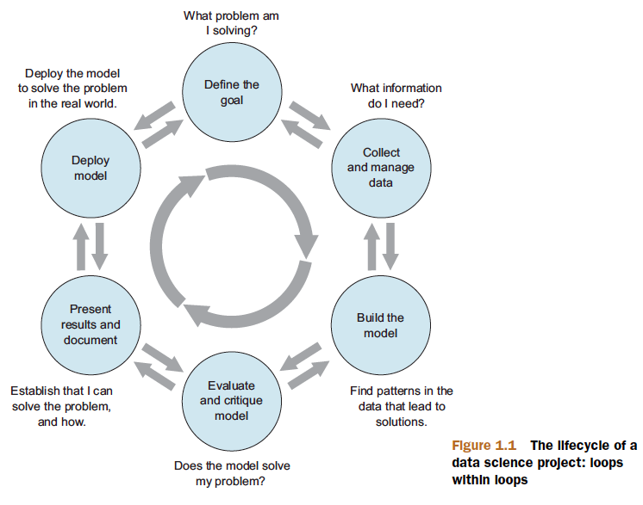
Data Science project
Find your own data set
Before midterm
Figure 1.1, Practical Data Science with R by Nina Zumel, John Mount

Slide 57
Modeling
The most common data science modeling tasks are these:
Classification—Deciding if something belongs to one category or another
Scoring—Predicting or estimating a numeric value, such as a price or probability
Ranking—Learning to order items by preferences
Clustering—Grouping items into most-similar groups
Finding relations—Finding correlations or potential causes of effects seen in the data
Characterization—Very general plotting and report generation from data
Practical Data Science with R by Nina Zumel, John Mount

Slide 58
Statistical Learning
3

Slide 59
Notation and Simple Matrix Algebra
n : the number of distinct data points, or observations, in our sample
p : the number of variables that are available for use in making predictions
Wage data set consists of 12 variables for 3,000 people
n=?
p=?
An Introduction to Statistical Learning with Applications in R by Gareth James, Daniela Witten, Trevor Hastie, Robert Tibshirani

Slide 60
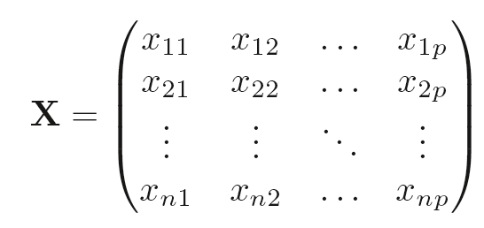
X denote a n x p matrix
An Introduction to Statistical Learning with Applications in R by Gareth James, Daniela Witten, Trevor Hastie, Robert Tibshirani

Slide 61
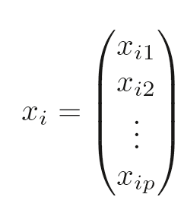
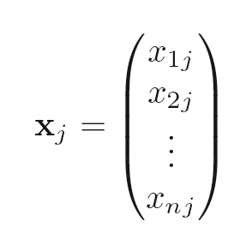
A person will be?
An Introduction to Statistical Learning with Applications in R by Gareth James, Daniela Witten, Trevor Hastie,Robert Tibshirani

Slide 62
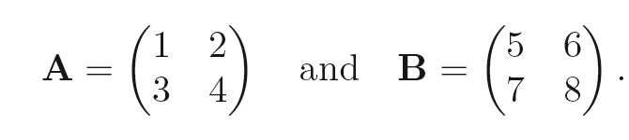
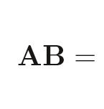
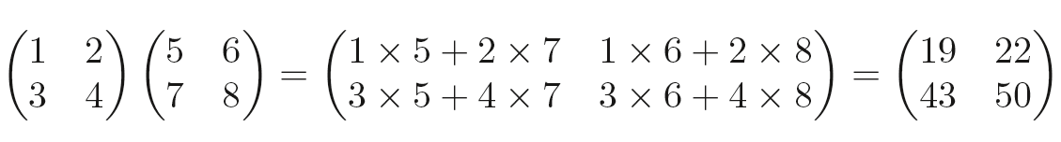
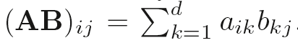
An Introduction to Statistical Learning with Applications in R by Gareth James, Daniela Witten, Trevor Hastie, Robert Tibshirani

Slide 63
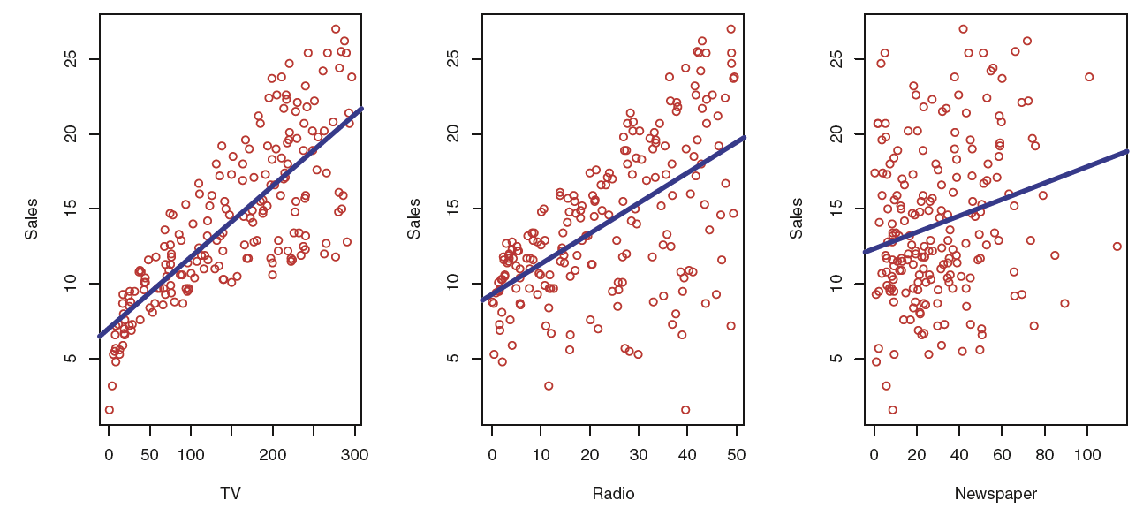
What is input? Output?
Figure 2.1, An Introduction to Statistical Learning with Applications in R by Gareth James, Daniela Witten, Trevor Hastie,Robert Tibshirani

Slide 64
The Advertising data set
The plot displays sales, in thousands of units, as a function of TV, radio, and newspaper budgets, in thousands of dollars, for 200 different markets.
Figure 2.1, An Introduction to Statistical Learning with Applications in R by Gareth James, Daniela Witten, Trevor Hastie, Robert Tibshirani

Slide 65
The Advertising data set
TV, radio, newspaper
predictors , independent variables , features , variable
typically denoted using the variable symbol X
Sales
response , dependent variable
typically denoted using the symbol Y
An Introduction to Statistical Learning with Applications in R by Gareth James, Daniela Witten, Trevor Hastie,Robert Tibshirani

Slide 66
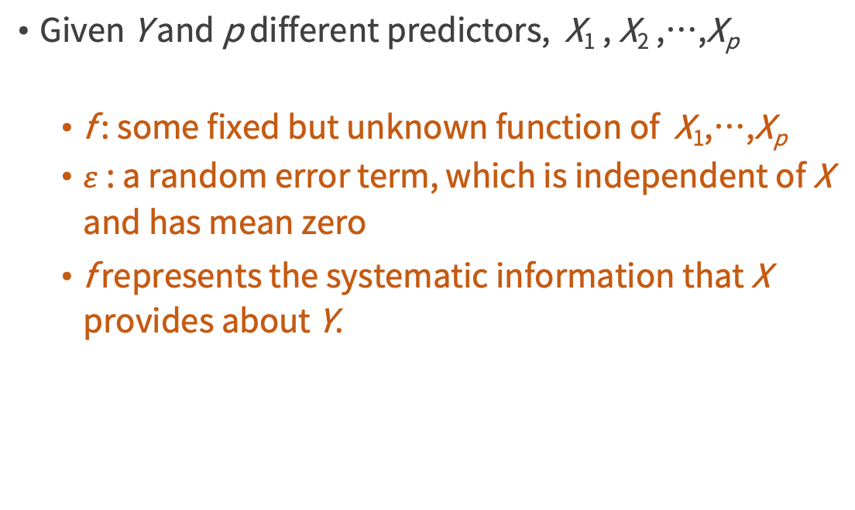
modeling
Given Y and p different predictors, X₁ , X₂ ,…,X_{p}
f : some fixed but unknown function of X₁,…,X_{p}
$ε$ : a random error term, which is independent of X and has mean zero
f represents the systematic information that X provides about Y.
An Introduction to Statistical Learning with Applications in R by Gareth James, Daniela Witten, Trevor Hastie,Robert Tibshirani

Slide 67
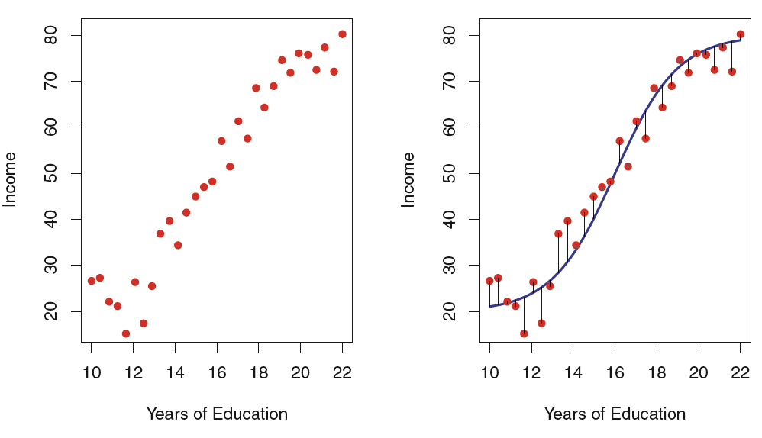
The Income data set
The red dots are the observed values of income (in tens of thousands of dollars) and years of education for 30 individuals.
What is f?
overall, the errors have approximately mean zero???
Figure 2.2, An Introduction to Statistical Learning with Applications in R by Gareth James, Daniela Witten, Trevor Hastie,Robert Tibshirani

Slide 68
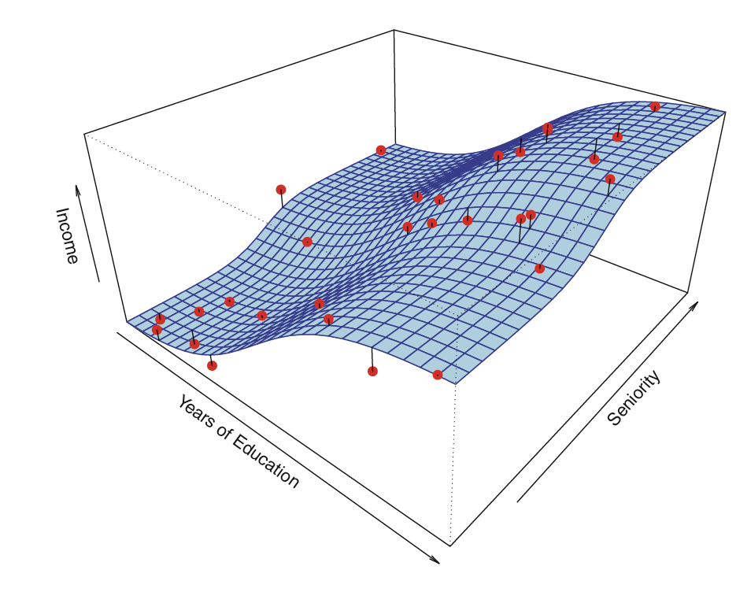
the function f may involve more than one input variable
Figure 2.3, An Introduction to Statistical Learning with Applications in R by Gareth James, Daniela Witten, Trevor Hastie,Robert Tibshirani

Slide 69
Practice Time
4

Slide 70
Installing R
CRAN : the comprehensive R archive network
the central repository for the most popular R libraries & serves the central role for R
A new major version of R comes out once a year, and there are 2-3 minor releases each year.
https://cloud.r-project.org
Instead use the cloud mirror, which automatically figures it out
R for Data Science by Garrett Grolemund, Hadley Wickham

Slide 71
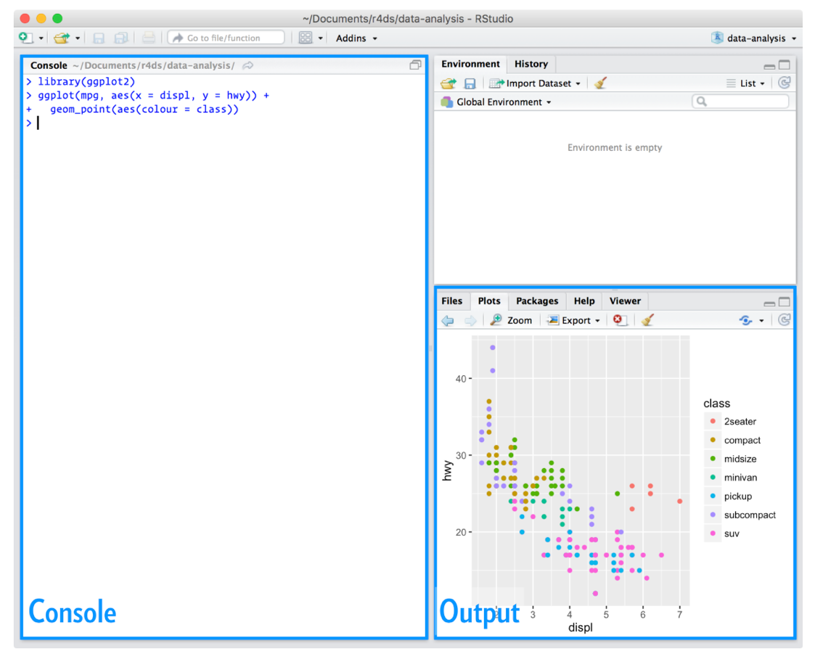
Installing RStudio
An integrated development environment, or IDE, for R programming.
https://www.rstudio.com/products/rstudio/download/
Figure 1.4.2, R for Data Science by Garrett Grolemund, Hadley Wickham

Slide 72
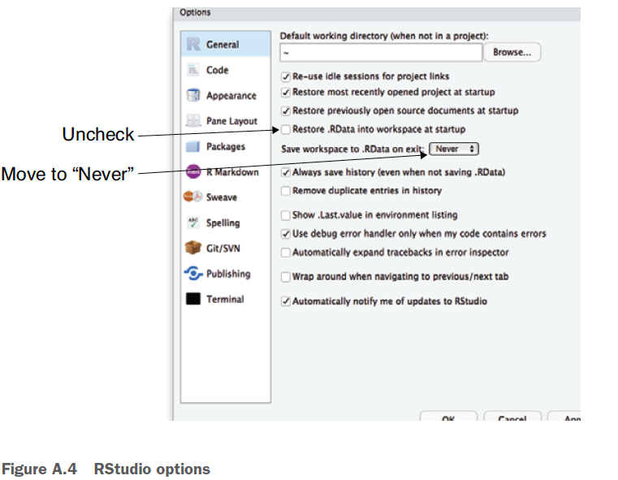
Work clean
To start with an empty workspace and explicitly bring in the packages, code, and data you want. This ensures you know how to get into your ready-to-go state (as you have to perform or write down the steps to get there) and you aren’t held hostage to state you don’t know how to restore (what we call the “no alien artifact” rule).
RStudio > Preferences, Tools > Global Options, Tools > Options
Figure A.4, Practical Data Science with R by Nina Zumel, John Mount

Slide 73
Basic Commands
R uses functions to perform operations.
funcname(input1, input2)
An Introduction to Statistical Learning with Applications in R by Gareth James, Daniela Witten, Trevor Hastie,Robert Tibshirani

Slide 74
Try the help command
Start R or RStudio and type help(ls) to get
documentation on the ls command used in our example
?funcname
Practical Data Science with R by Nina Zumel, John Mount

Slide 75
Starting with R
How to use package?
install.package(’ctv’)
library(‘ctv’)
How many packages?
https://cran.r-project.org/web/views/
Practical Data Science with R by Nina Zumel, John Mount

Slide 76
Basic Commands
x <- c(1,3,2,5)
x=c(1,6,2)
y=c(1,4,3)
length(x)
length(y)
x+y
An Introduction to Statistical Learning with Applications in R by Gareth James, Daniela Witten, Trevor Hastie,Robert Tibshirani

Slide 77
Basic Commands
ls()
rm(x,y)
ls()
rm(list=ls())
An Introduction to Statistical Learning with Applications in R by Gareth James, Daniela Witten, Trevor Hastie,Robert Tibshirani

Slide 78
Basic Commands
?matrix
x=matrix(data=c(1,2,3,4) , nrow=2, ncol =2)
x=matrix(c(1,2,3,4) ,2,2)
matrix(c(1,2,3,4) ,2,2,byrow =TRUE)
sqrt(x)
x^2
An Introduction to Statistical Learning with Applications in R by Gareth James, Daniela Witten, Trevor Hastie,Robert Tibshirani

Slide 79
Basic Commands
x=rnorm(50)
y=x+rnorm(50, mean=50, sd=.1)
cor(x,y)
An Introduction to Statistical Learning with Applications in R by Gareth James, Daniela Witten, Trevor Hastie,Robert Tibshirani

Slide 80
Basic Commands
set.seed(1303)
rnorm(50)
An Introduction to Statistical Learning with Applications in R by Gareth James, Daniela Witten, Trevor Hastie,Robert Tibshirani

Slide 81
Basic Commands
set.seed (3)
y=rnorm (100)
mean(y)
var(y)
sqrt(var(y))
sd(y)
An Introduction to Statistical Learning with Applications in R by Gareth James, Daniela Witten, Trevor Hastie,Robert Tibshirani

Slide 82
sessionInfo()
what packages are present in your session
Very information for reproducing your analysis
=> keep essential information when writing paper
Practical Data Science with R by Nina Zumel, John Mount

Slide 83
R語言翻轉教室
http://datascienceandr.org/
By Wush Wu、Chih Cheng Liang、Johnson Hsieh

Slide 84
Getting help and learning more
If you get stuck, start with Google. Typically adding “R” to a query is enough to restrict it to relevant results
If Google doesn’t help, try stackoverflow. Start by spending a little time searching for an existing answer, including [R] restrict your search to questions and answers that use R.
R for Data Science by Garrett Grolemund, Hadley Wickham

Slide 85
Getting help and learning more
If you get stuck, start with Google. Typically adding “R” to a query is enough to restrict it to relevant results
If Google doesn’t help, try stackoverflow. Start by spending a little time searching for an existing answer, including [R] restrict your search to questions and answers that use R.
R for Data Science by Garrett Grolemund, Hadley Wickham

Slide 86
Webs
Stack Overflow R section : A Q&A site: http://stackoverflow.com/questions/tagged/r
LearnR : A translation of all the plots from Lattice: Multivariate Data Visualization with R (Use R!) (by D. Sarker; Springer, 2008) into ggplot2: http://learnr.wordpress.com
R-bloggers : A high-quality R blog aggregator: http://www.r-bloggers.com
Courses http://dataology.blogspot.tw/
R programming
Norman Matloff, The Art of R Programming
Garrett Grolemund, Hands-On Programming with R
R plus statistics
Robert Kabacoff R in Action (2nd edition) Quick-R http://www.statmethods.net/
Jared P. Lander R for Everyone
Data Science
Cathy O’Neil, Rachel Schutt Doing Data Science
Nina Zumel, John Mount Practical Data Science with R
Machine Learning
James et. al. An Introduction to Statistical Learning
Haste et. al. The Elements of Statistical Learning
Free ebooks @ http://dataology.blogspot.tw/2015/09/60.html
http://winvector.github.io/IntroductionToDataScience/

Slide 87


Thank You Any Question?

